Slide 1

E-HEALTHCARE MANAGEMENT SYSTEM
University-Id:-1911985066
Name:-Moksh Teng

Slide 2

PURPOSE
The e-Healthcare management system is a web-based project that seeks to provide effective management of employee data and medical data of patients in hospitals and clinics.
It consists of 3 modules: an administration module, doctor module and patient module.
While the administration module is concerned with medicare management that includes doctors and appointments.
The doctor module is concerned with appointments and creating medical records for patients.
The patient module is for clients concerned with booking appointments.

Slide 3

TOPIC DESCRIPTIONS
It’s an online Health Care Management service which is named Zencare. It’s convenient, it gives you the widest choice possible and it can be done sitting in the privacy of one’s cubicle. It consists of 3 modules: an administration module, doctor module and patient module.
Today when professionals across the world are spending 10-12 hours at work every day, Online Health Care Management reduces the time and complexity.
The system after careful analysis has been identified to be presented with the following modules.
The modules involved are:
ADMIN MODULE .
DOCTOR MODULE.
PATIENT MODULE .

Slide 4
TECHNOLOGIES DESCRIPTION
Front-end technologies: HTML, CSS, JS, React JS, Axios, Yup, React Router, Bootstrap.
Backend technologies: Java, Spring Boot, Spring Core, Spring Security(with JWT), Hibernate ORM, Spring Boot JPA, MySQL, Spring Boot Starter Validation, Spring Boot Starter Mail.

Slide 5






Slide 6
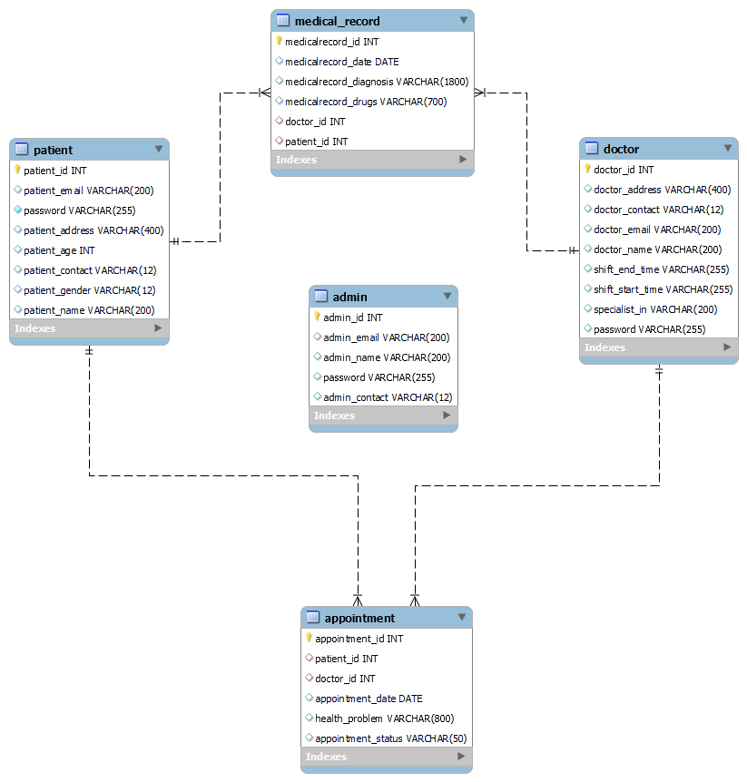
UML DIAGRAM

Slide 7
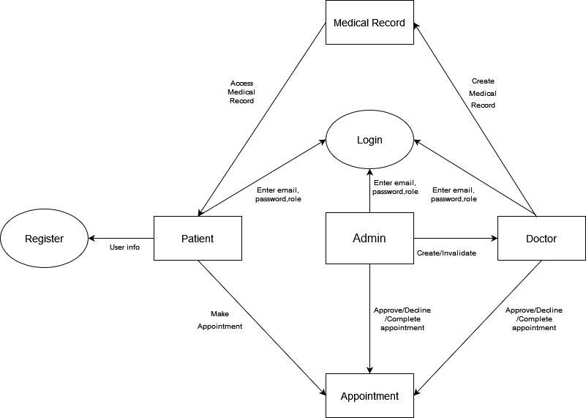

Slide 8
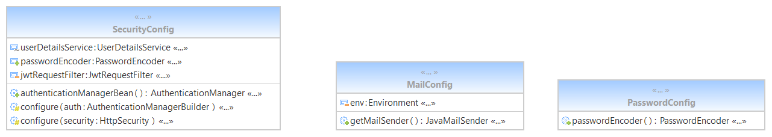

Slide 9
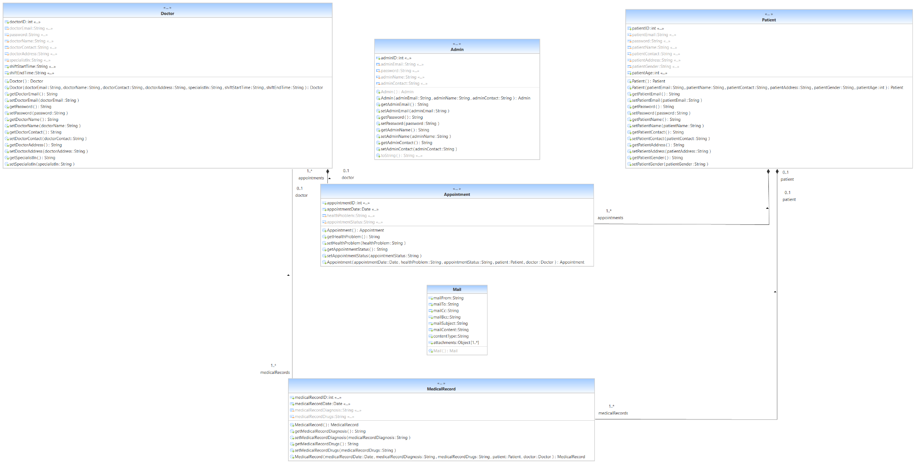

Slide 10
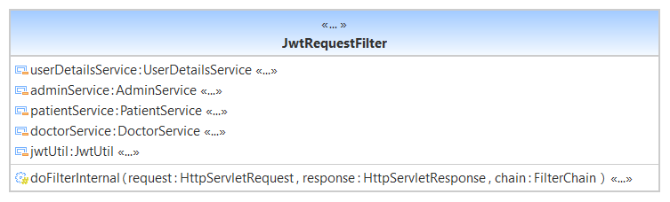
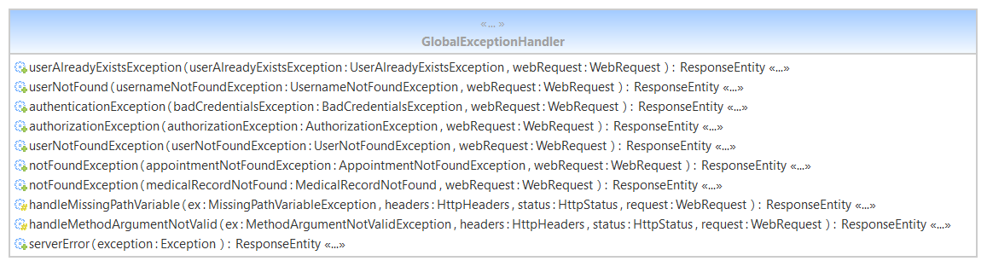

Slide 11
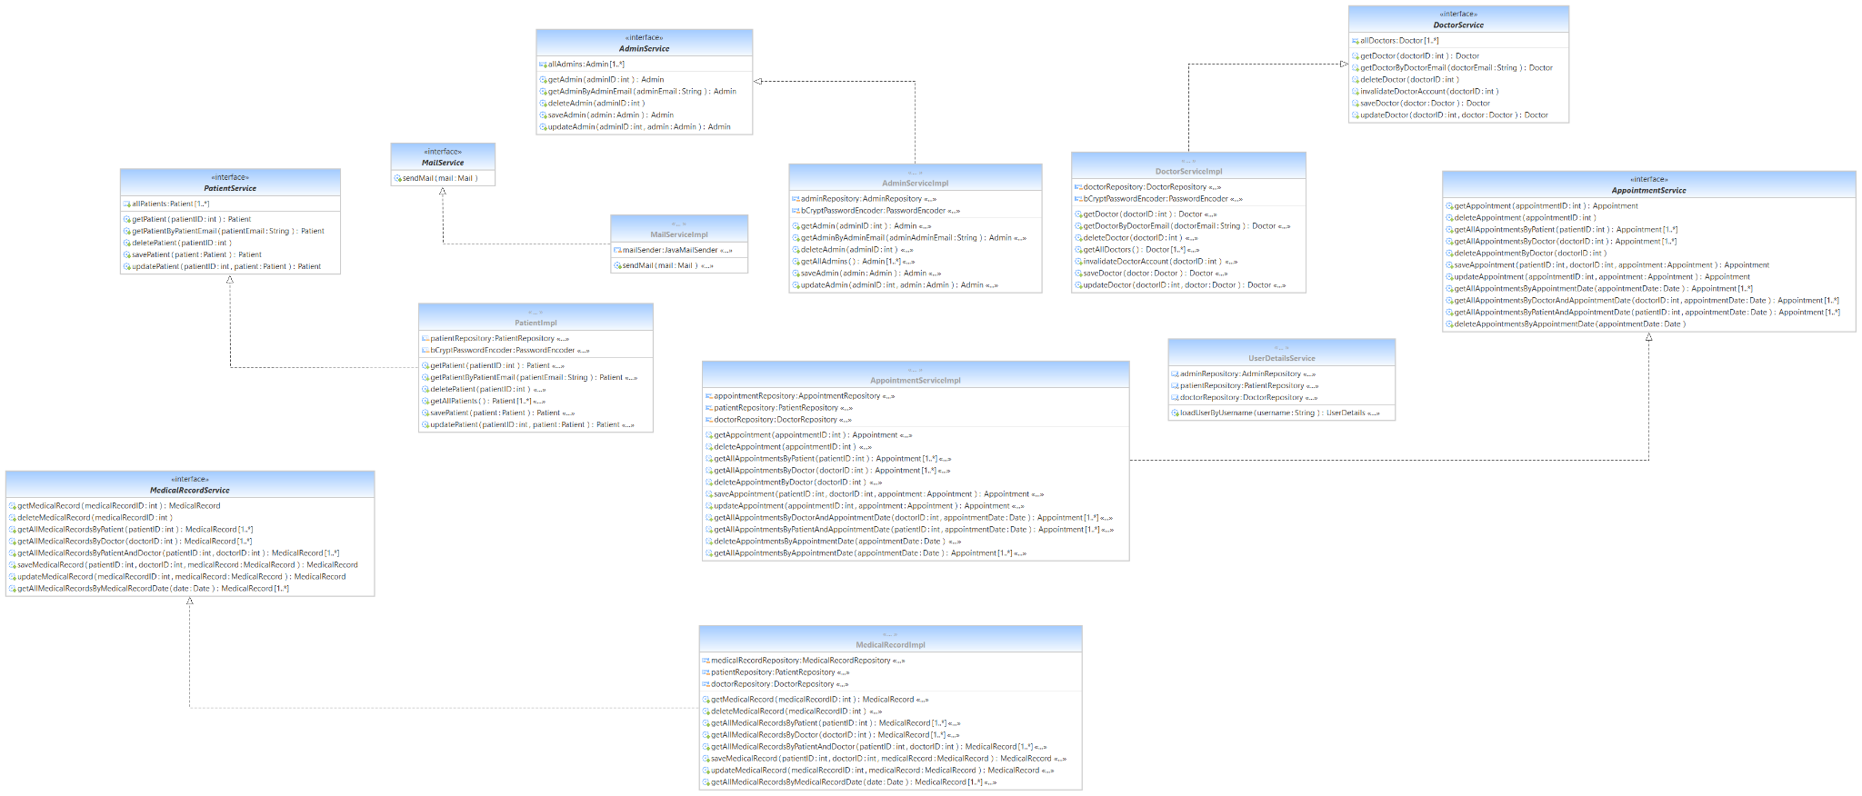
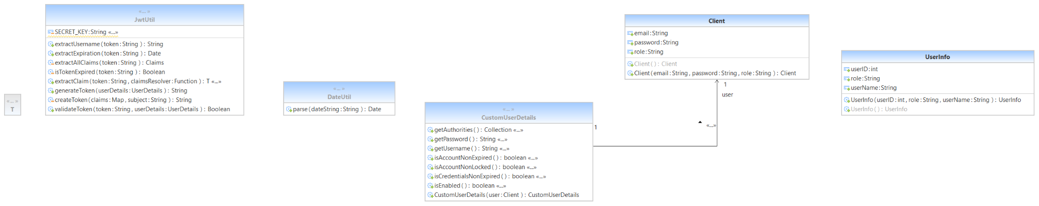

Slide 12
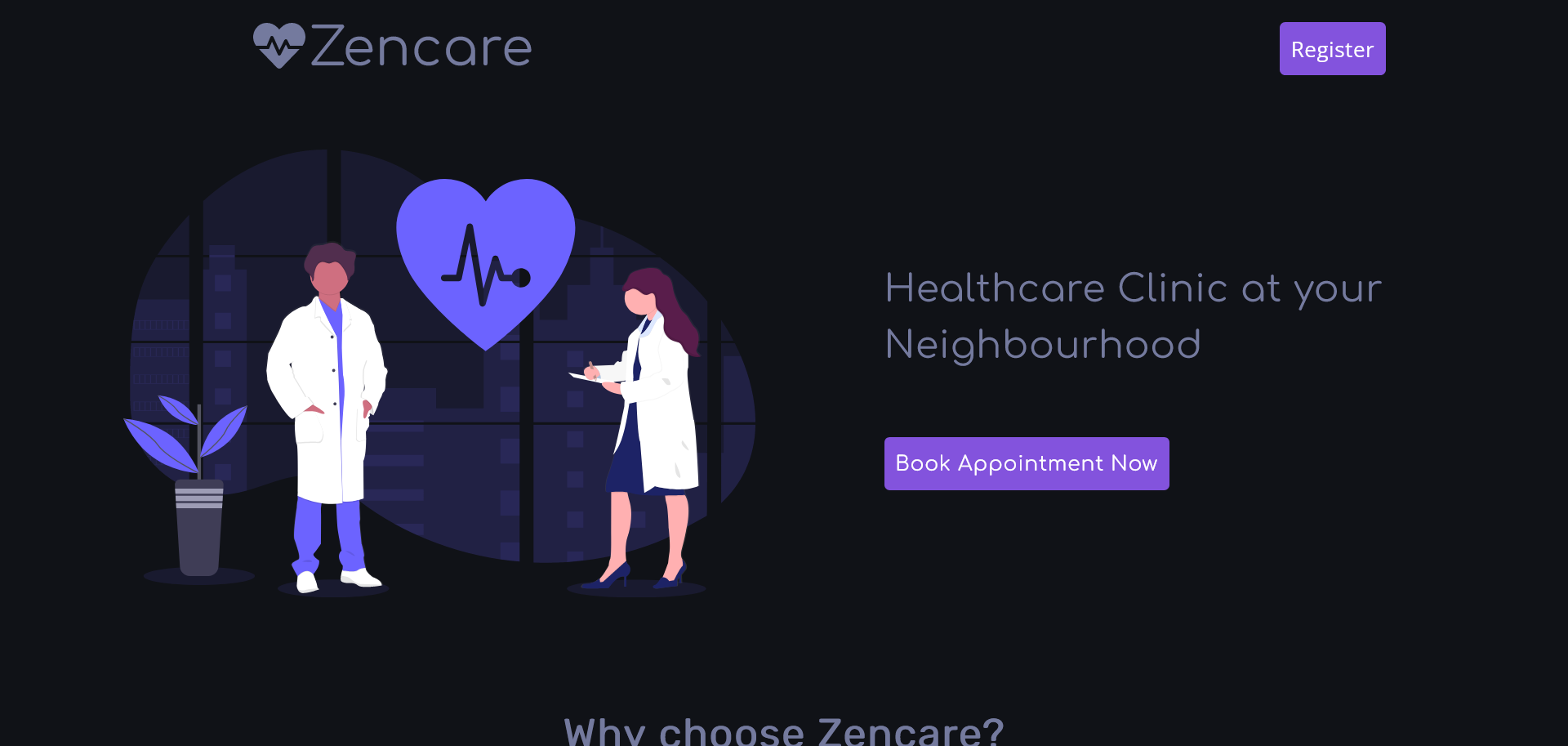
SCREENSHOT

Slide 13
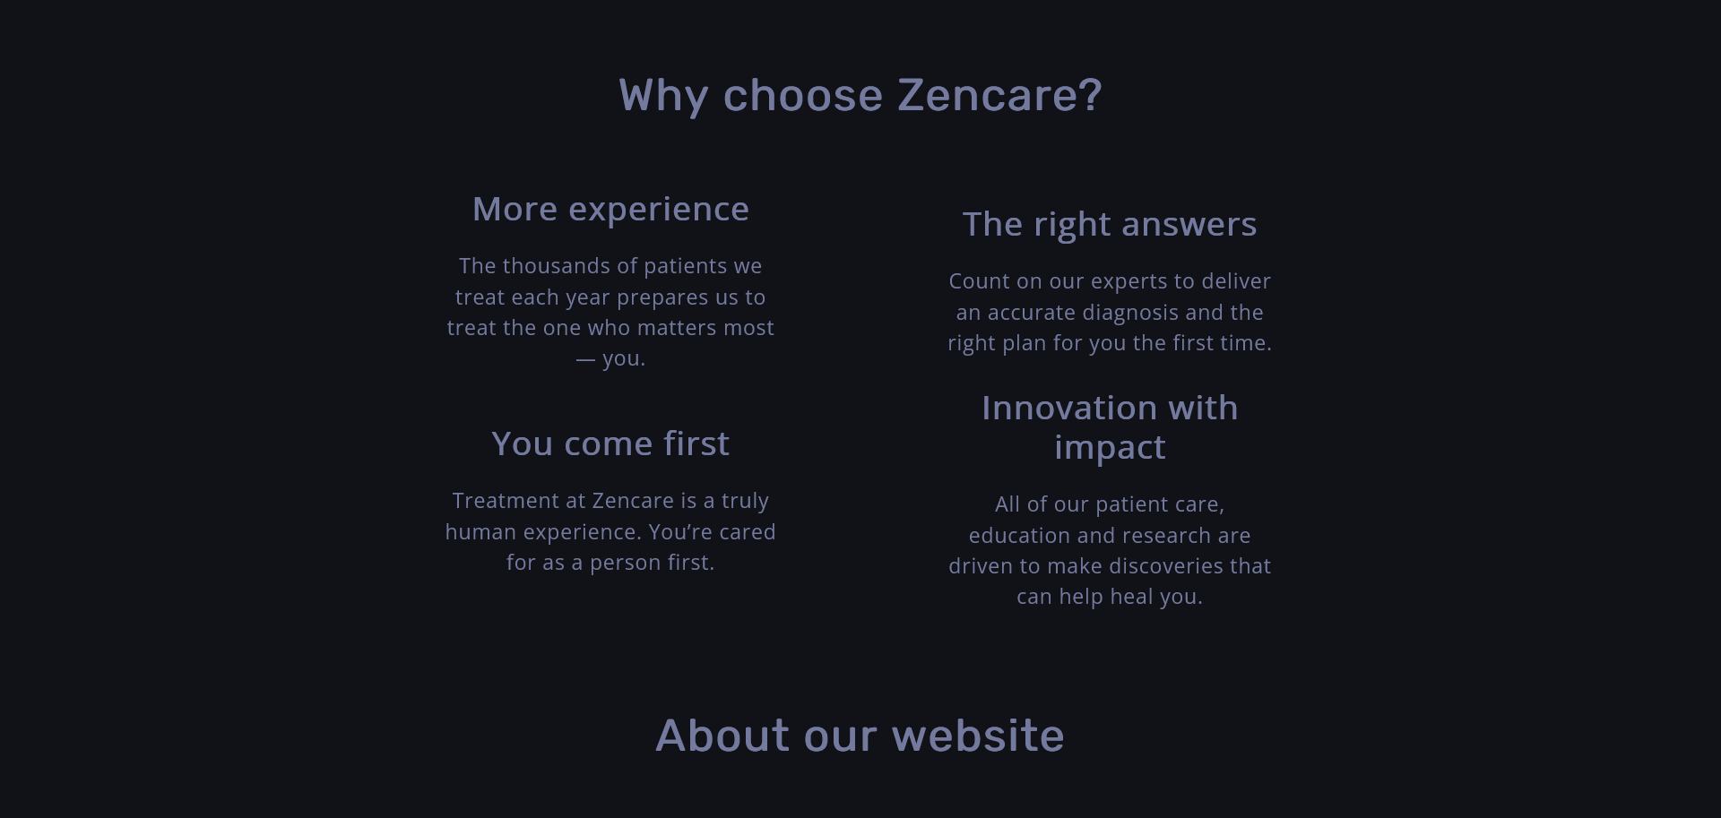
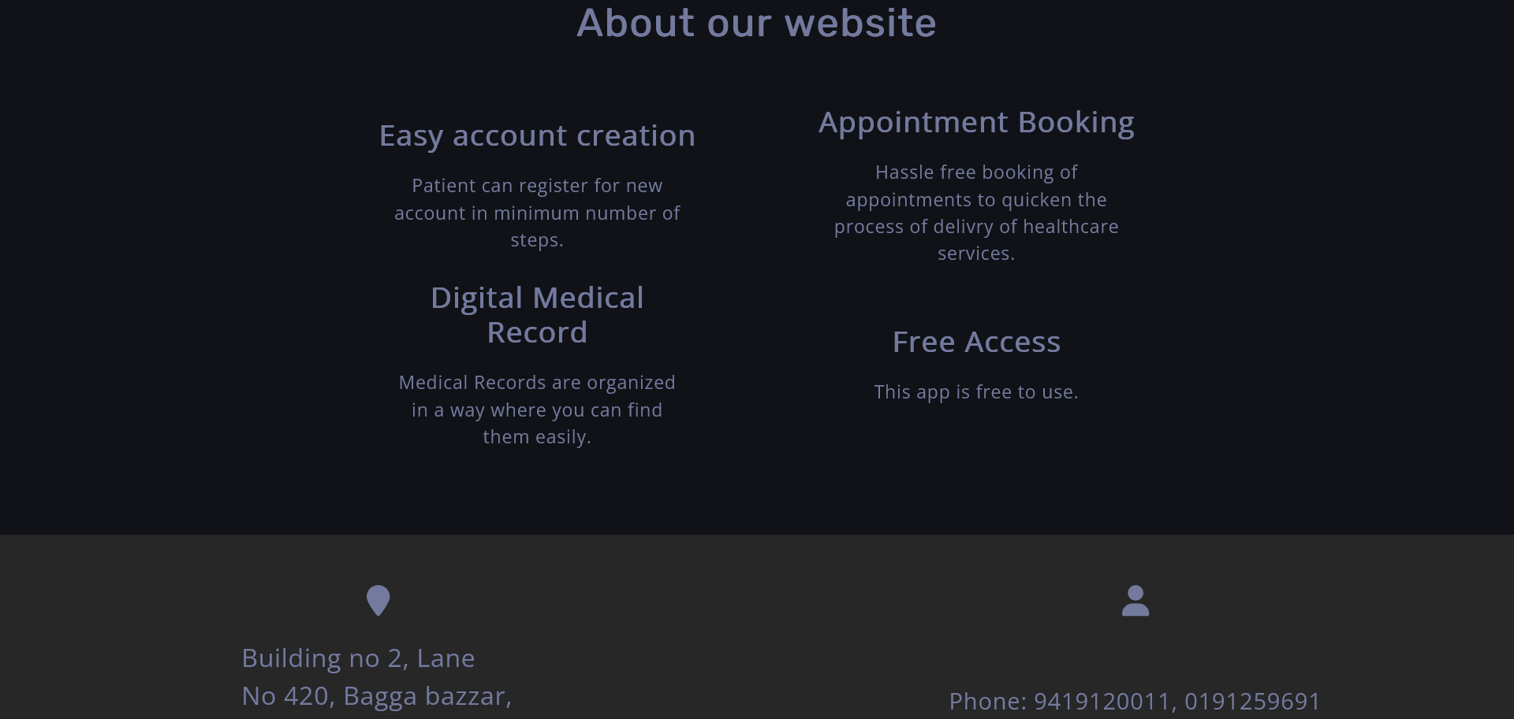

Slide 14
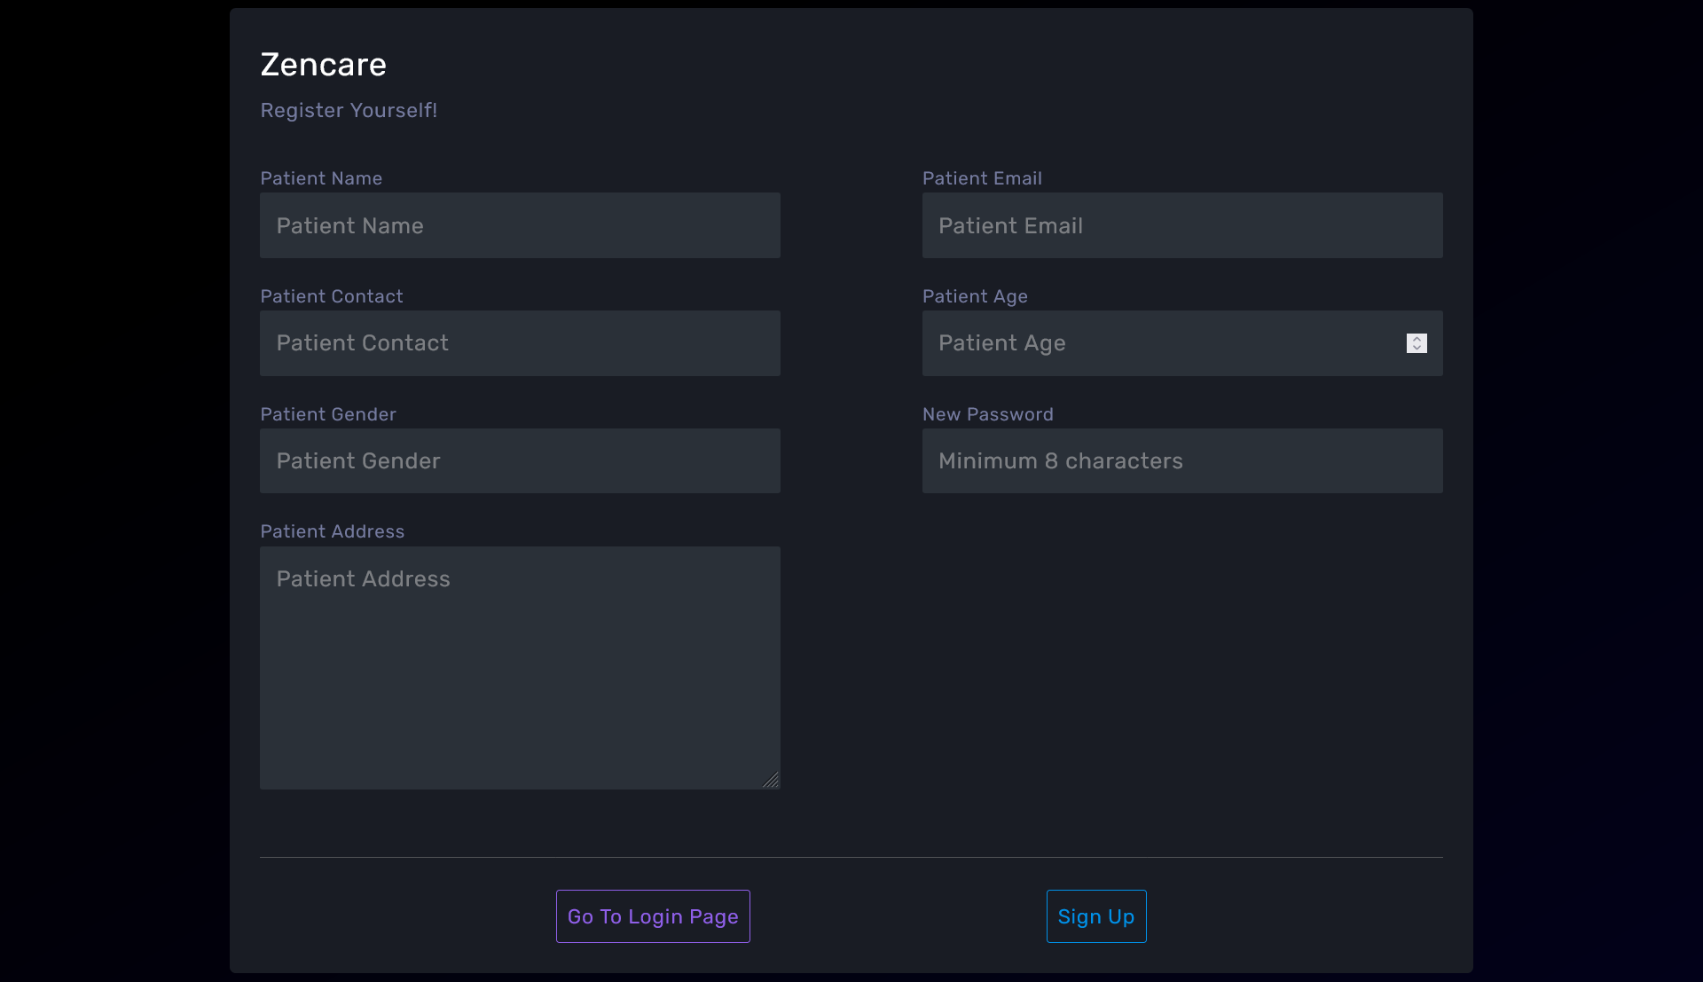

Slide 15
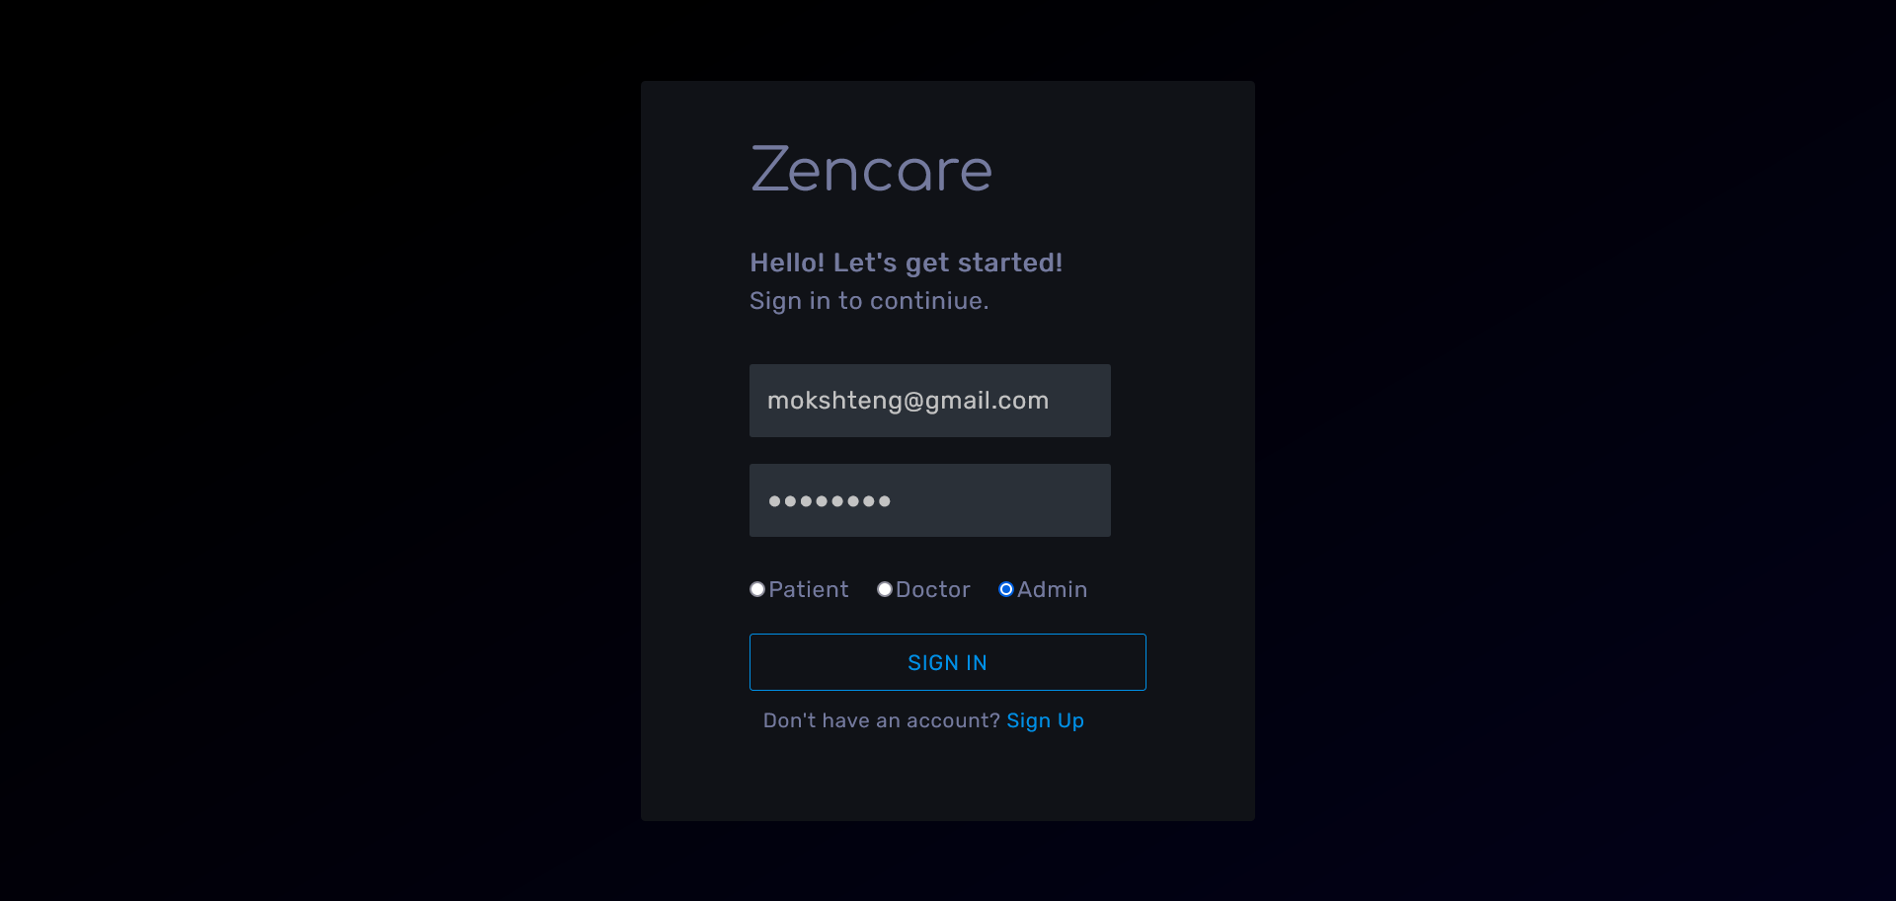

Slide 16
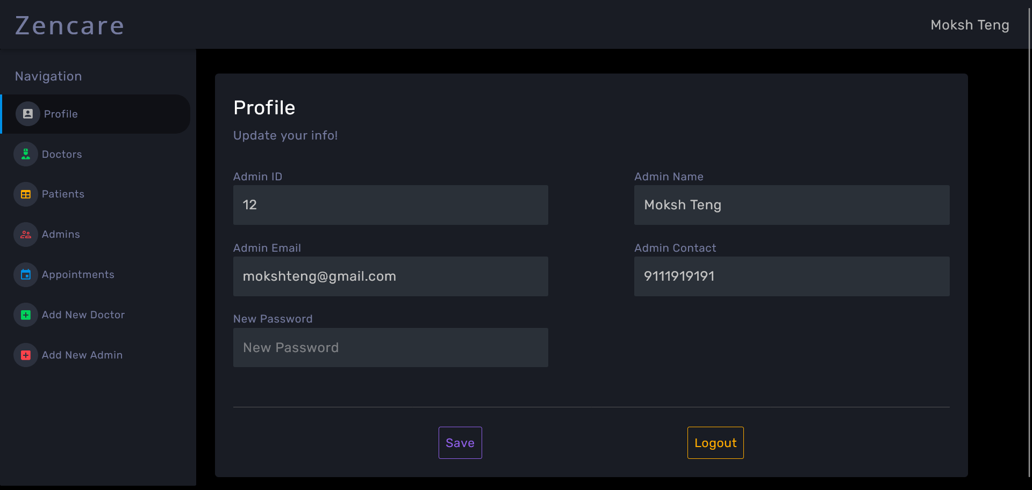

Slide 17
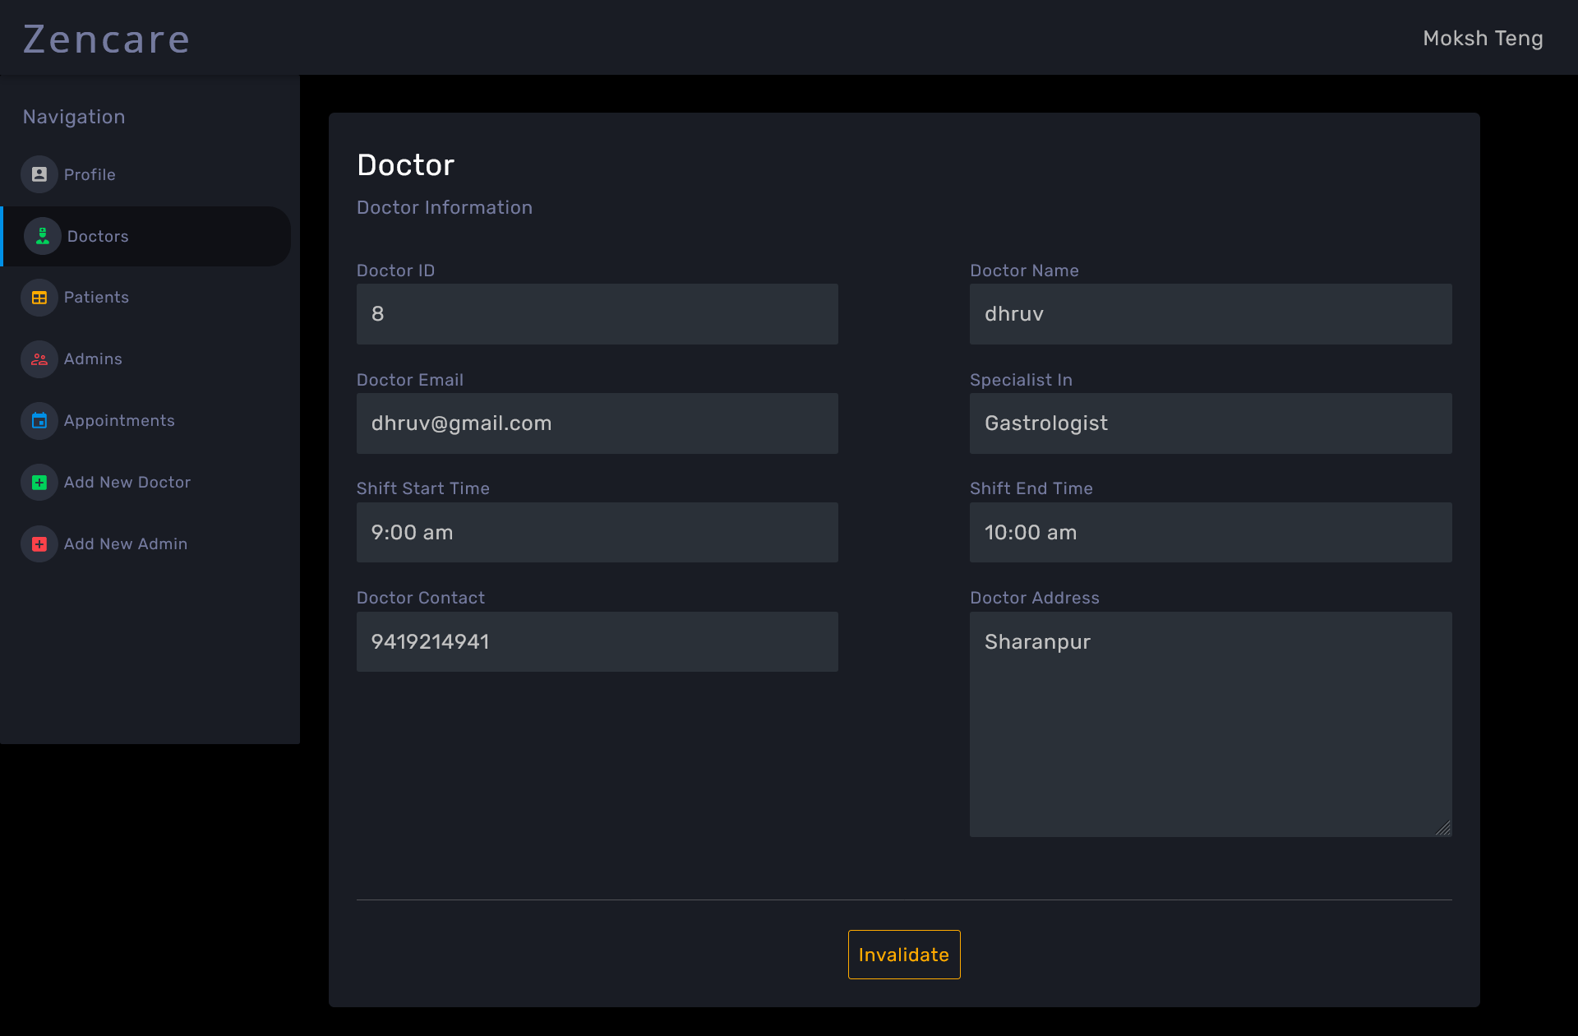

Slide 18
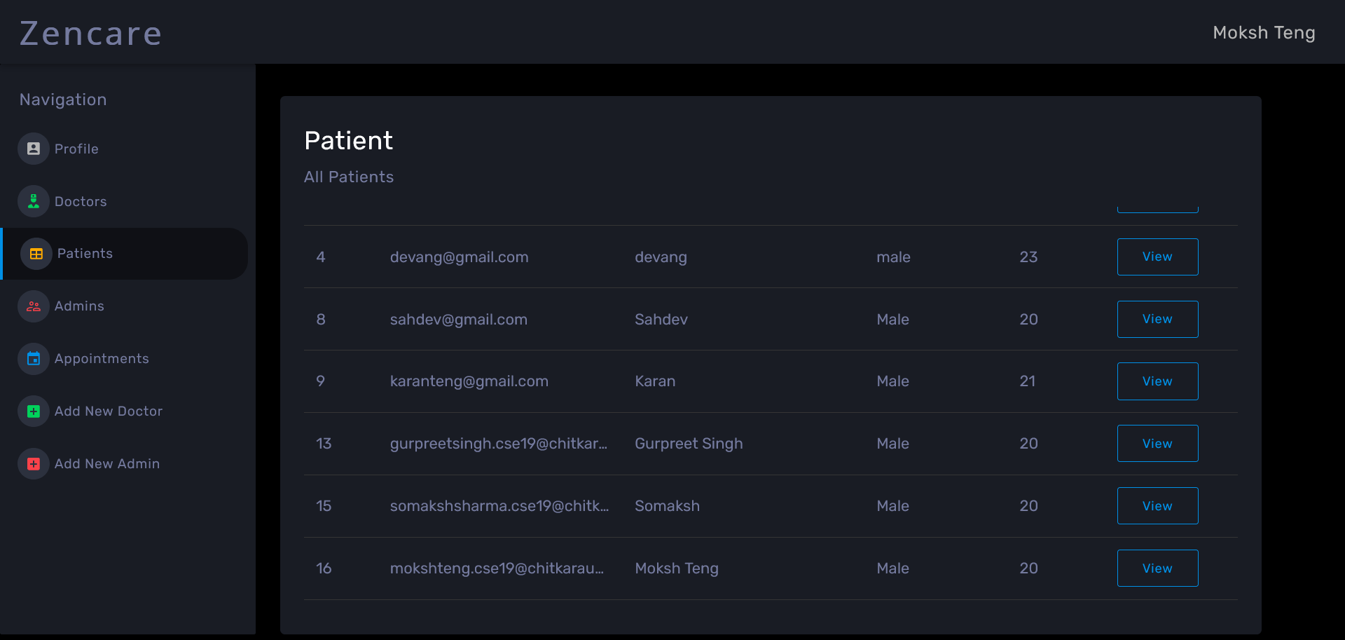

Slide 19
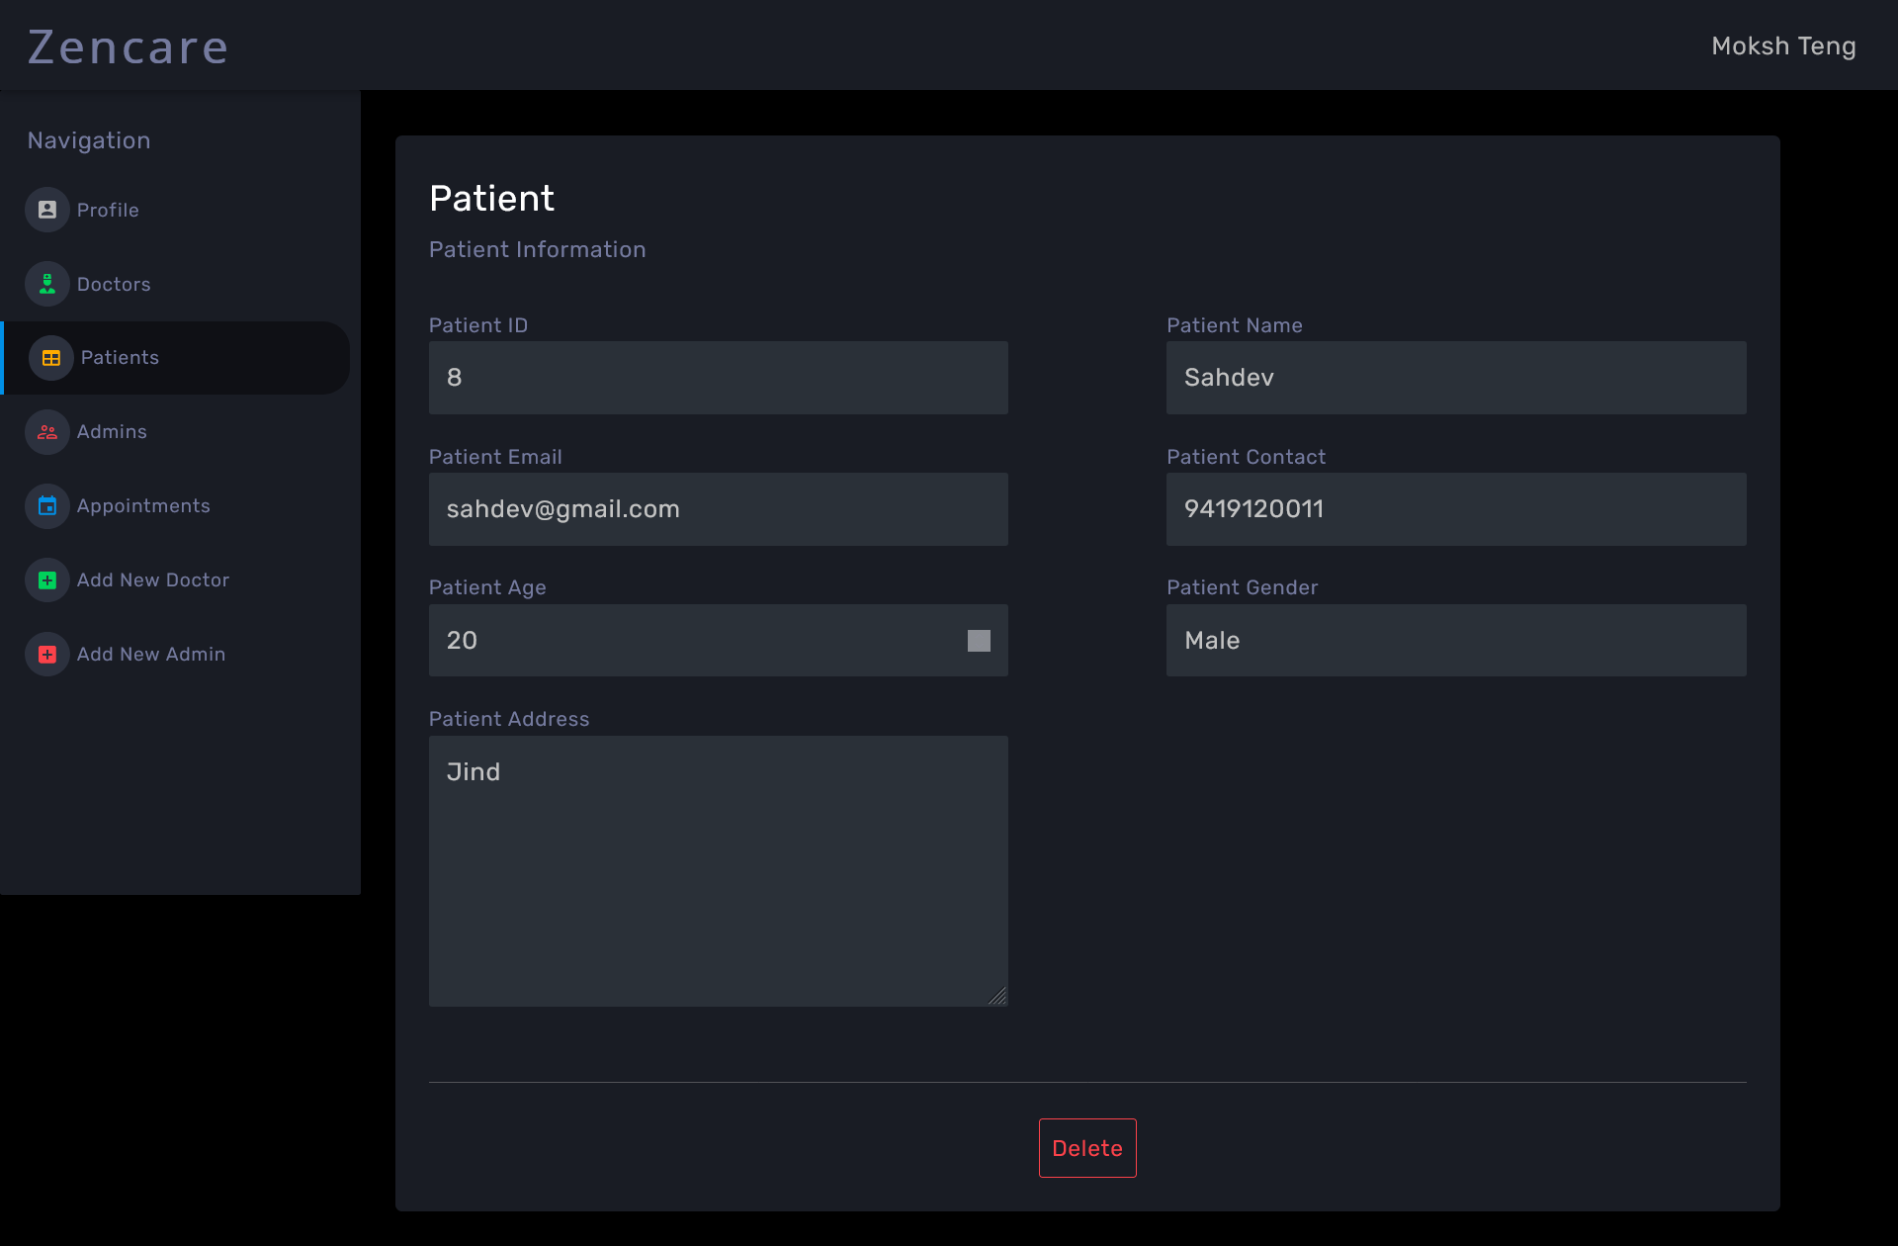

Slide 20
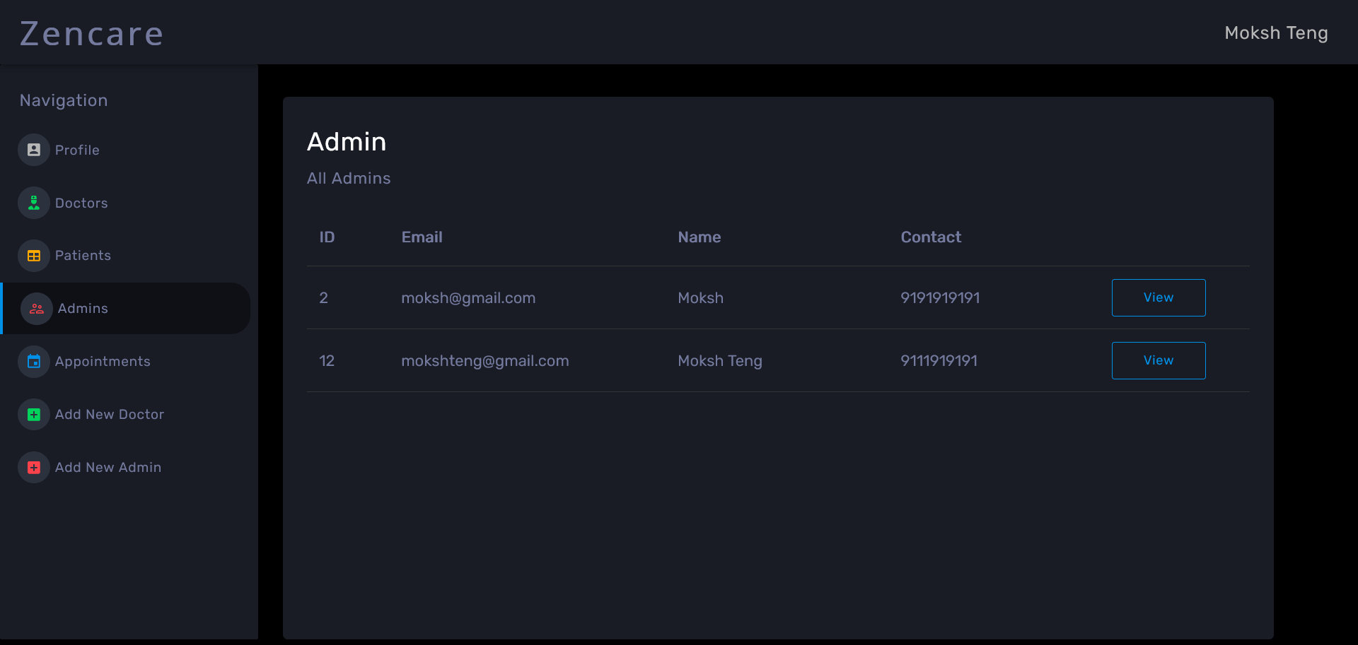

Slide 21
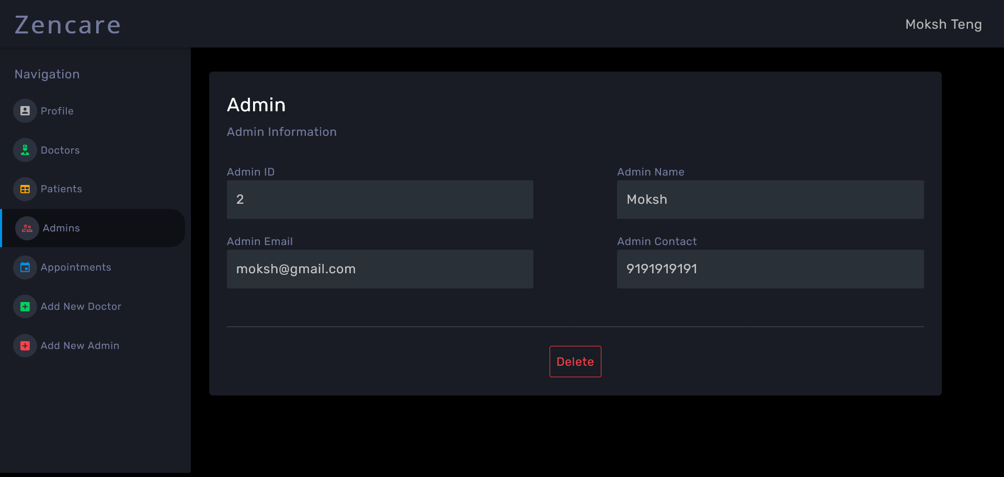

Slide 22
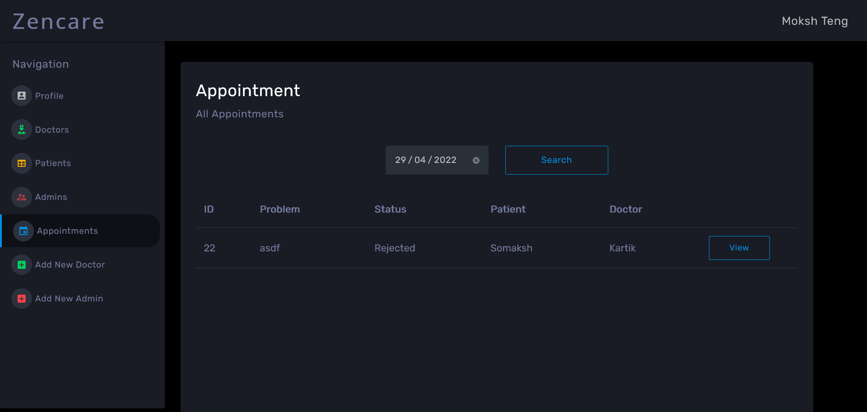

Slide 23
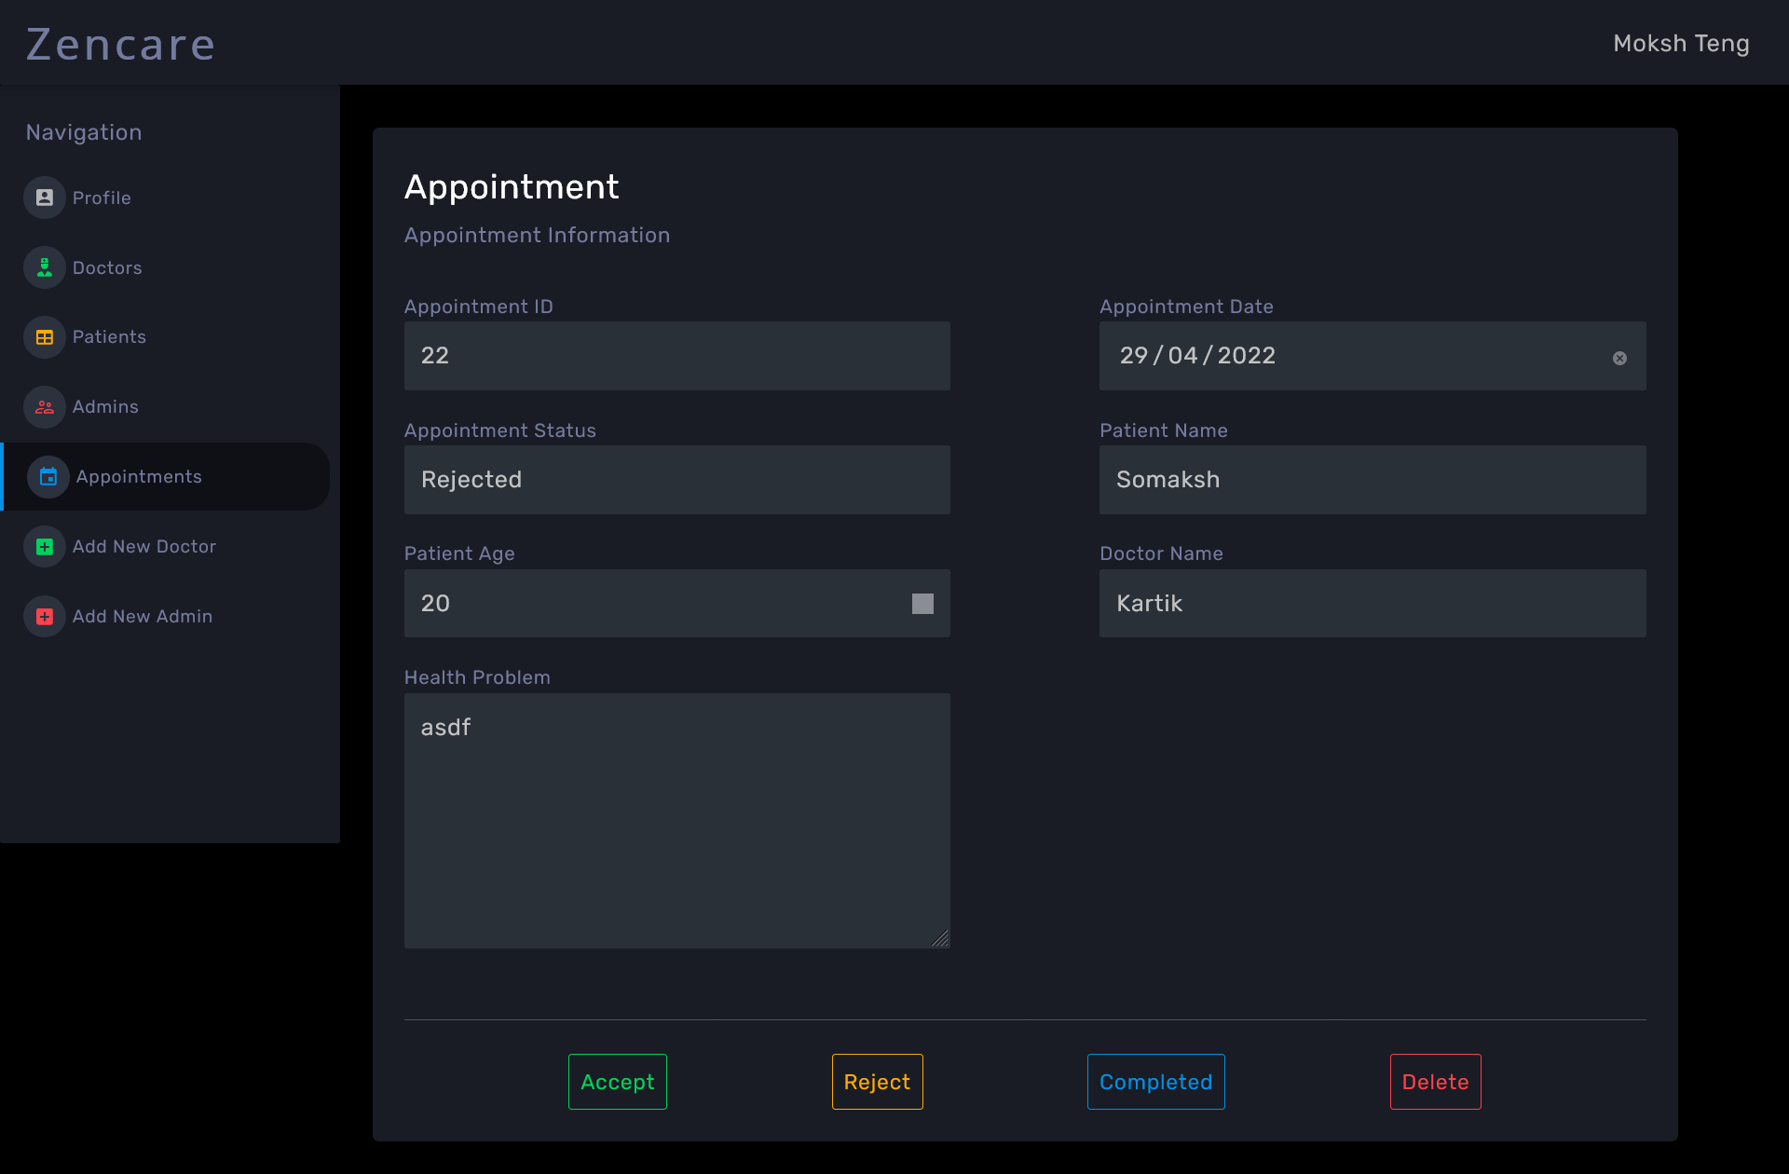

Slide 24
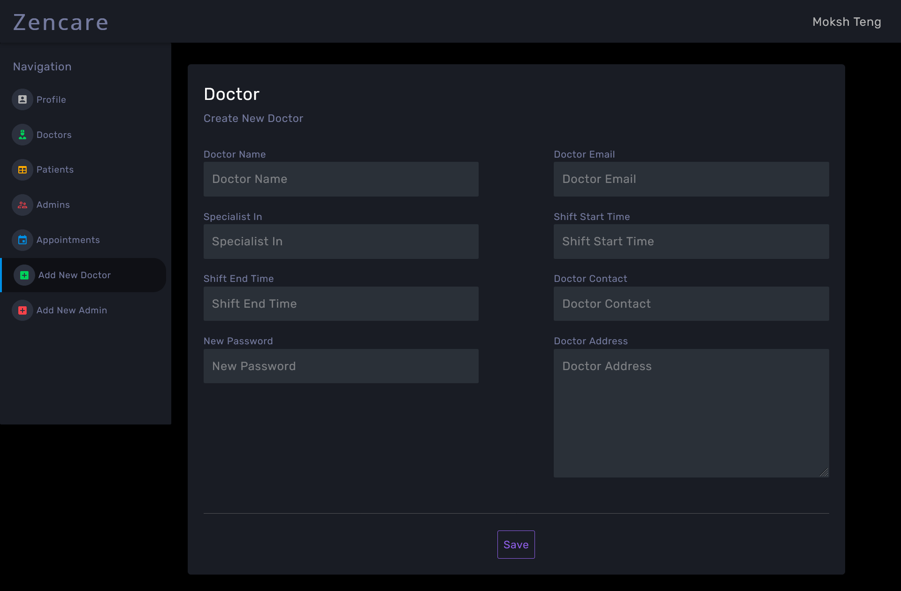

Slide 25
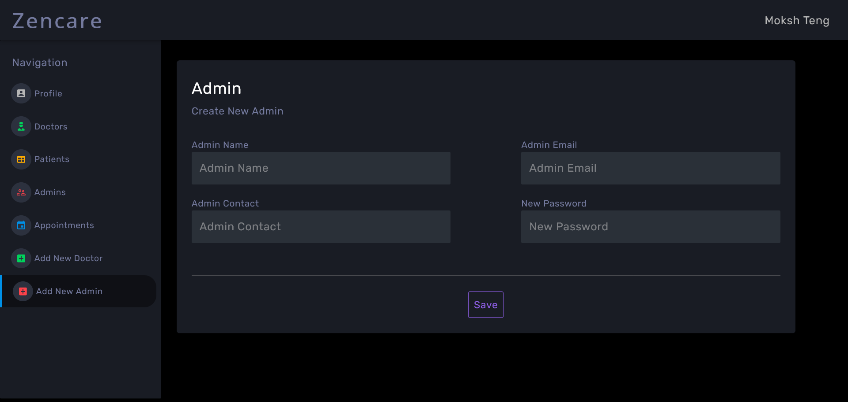

Slide 26
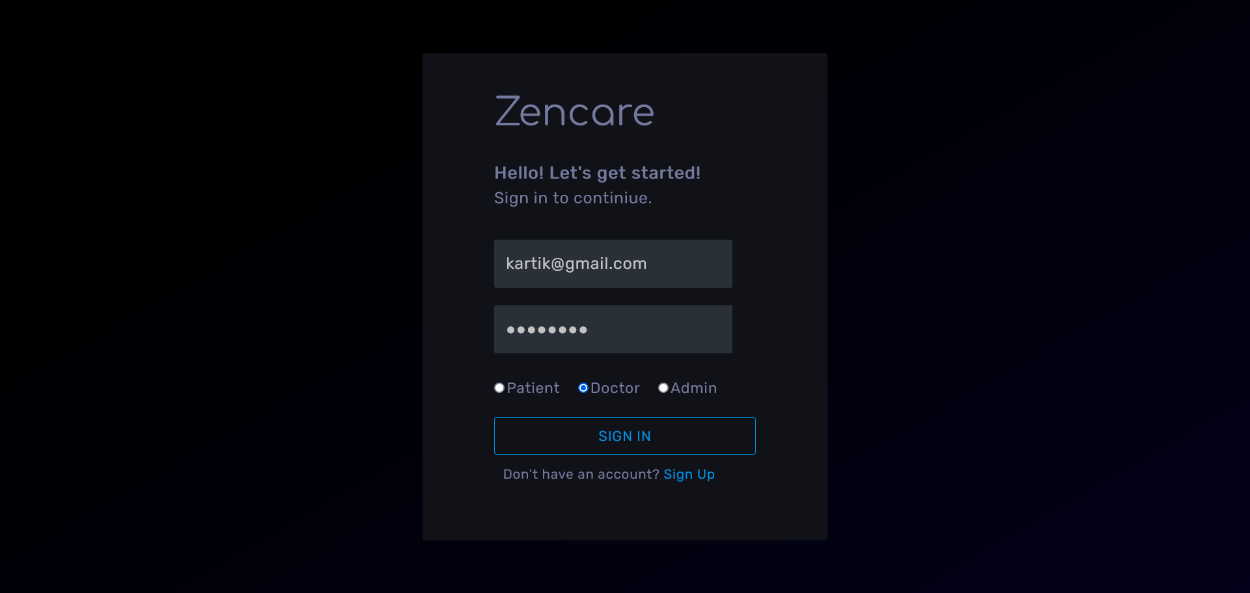

Slide 27
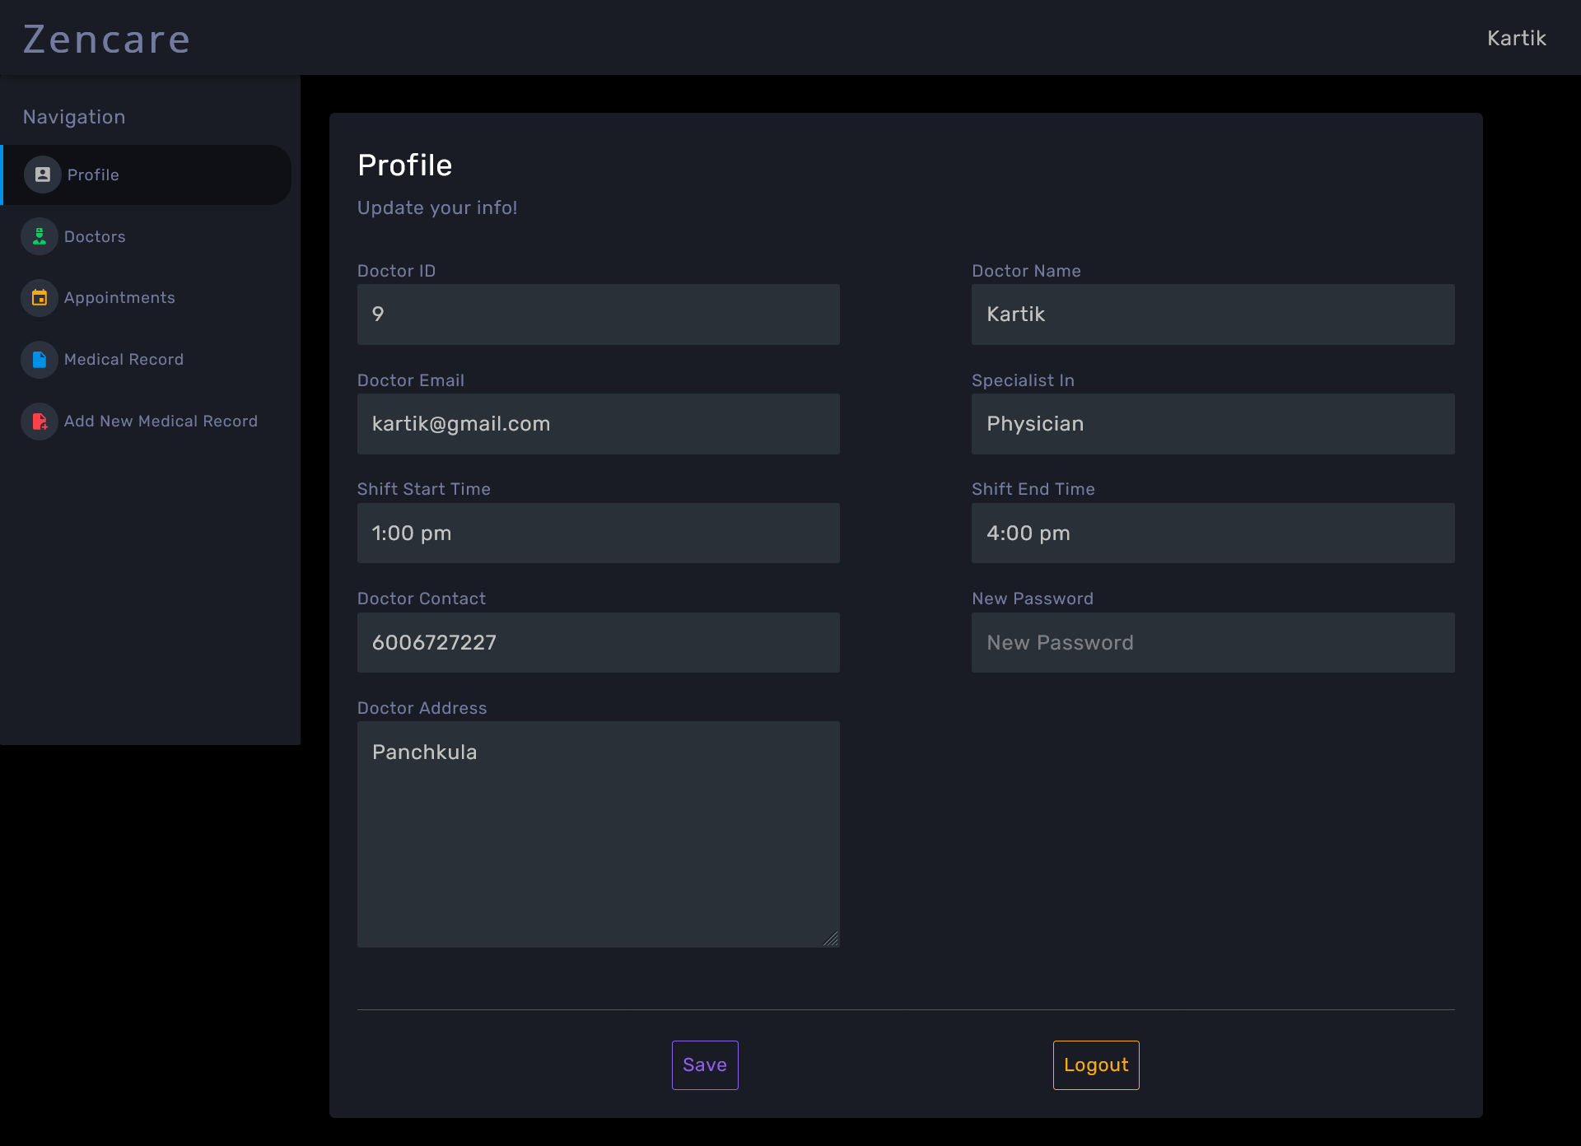

Slide 28
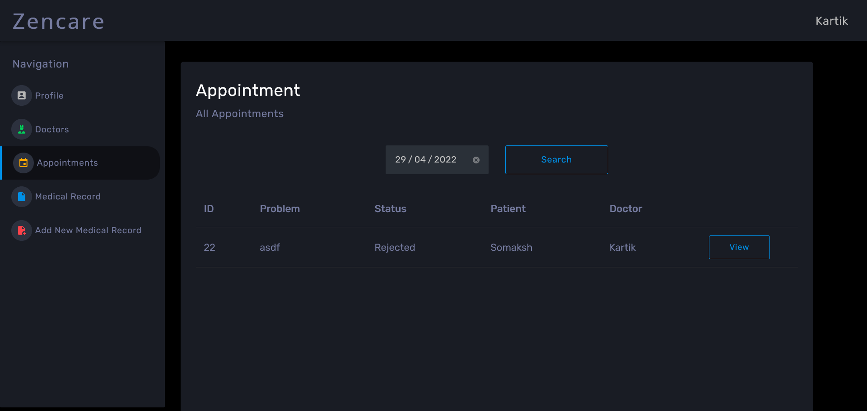

Slide 29
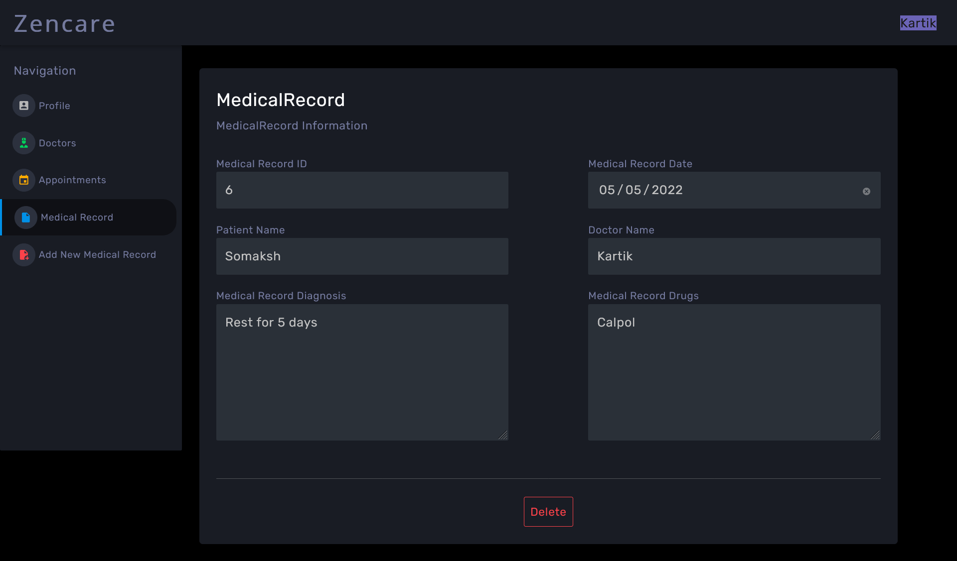

Slide 30
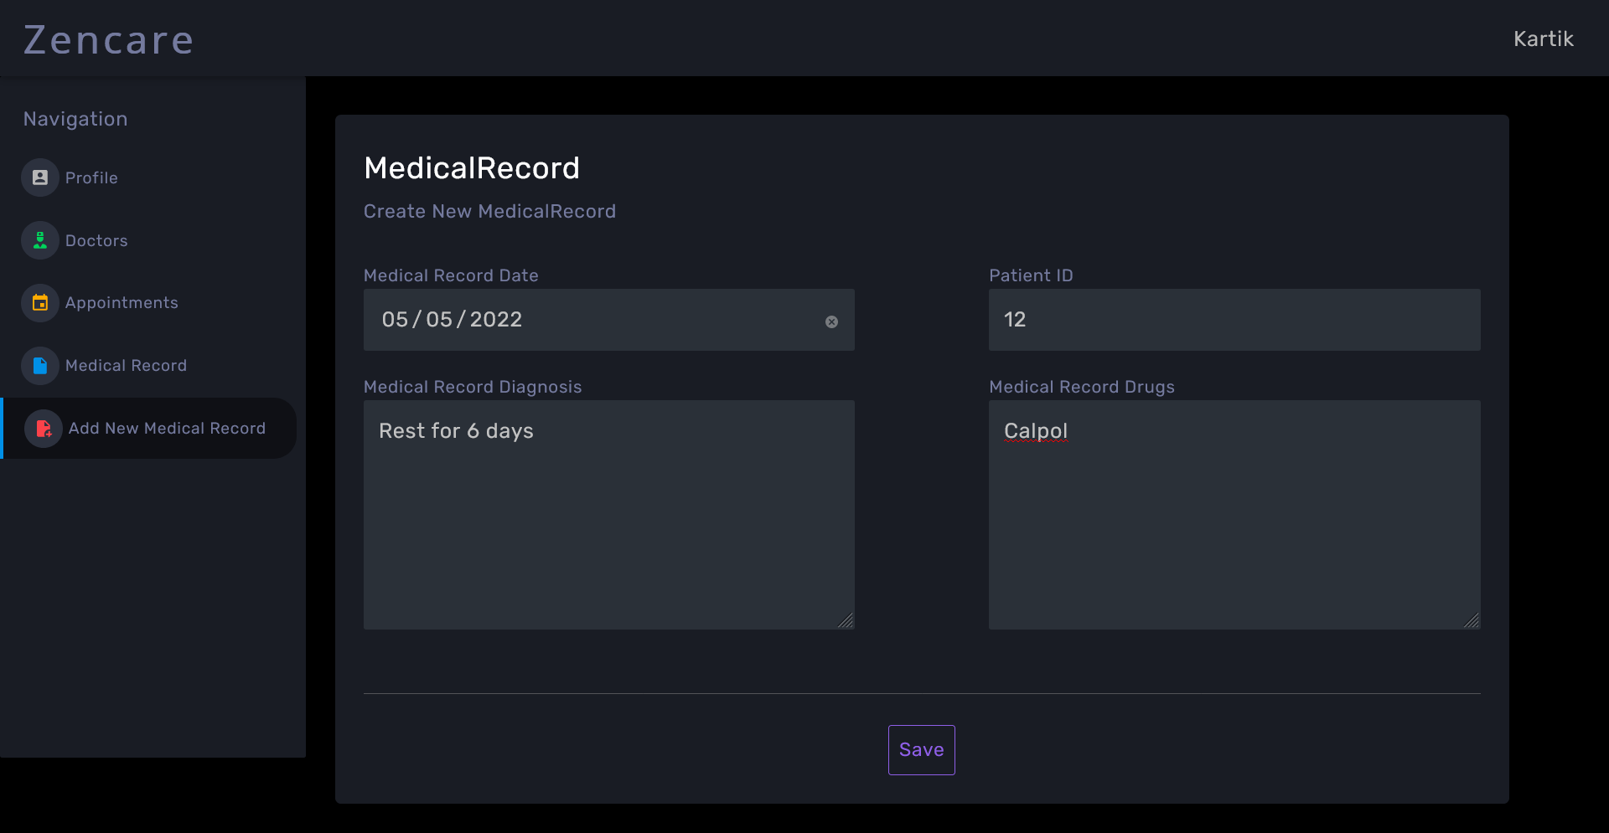

Slide 31
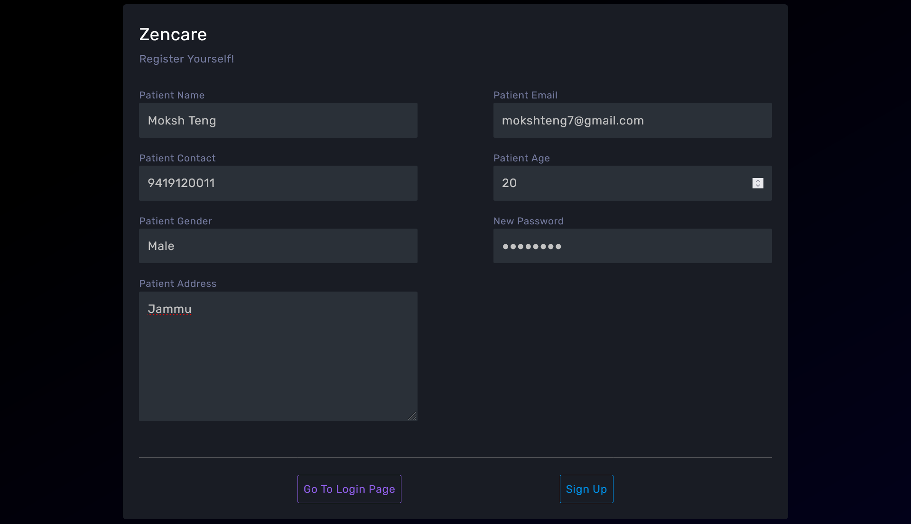

Slide 32
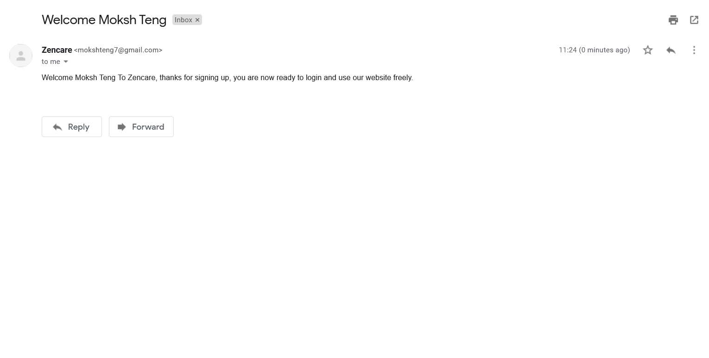

Slide 33
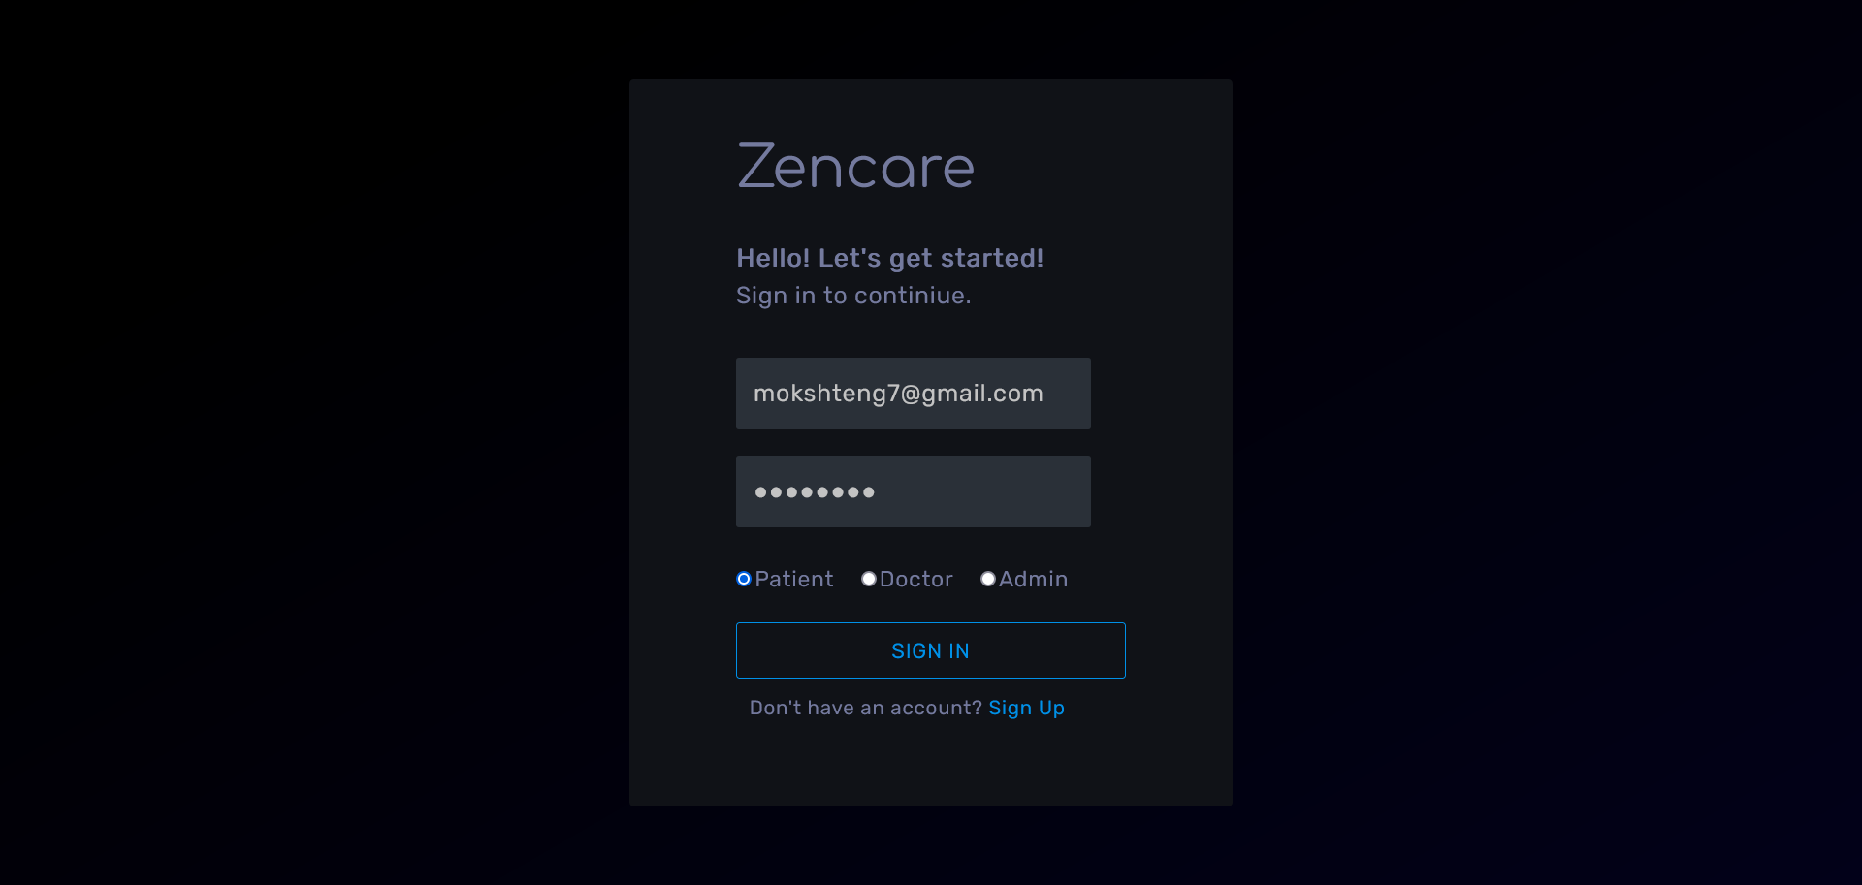

Slide 34
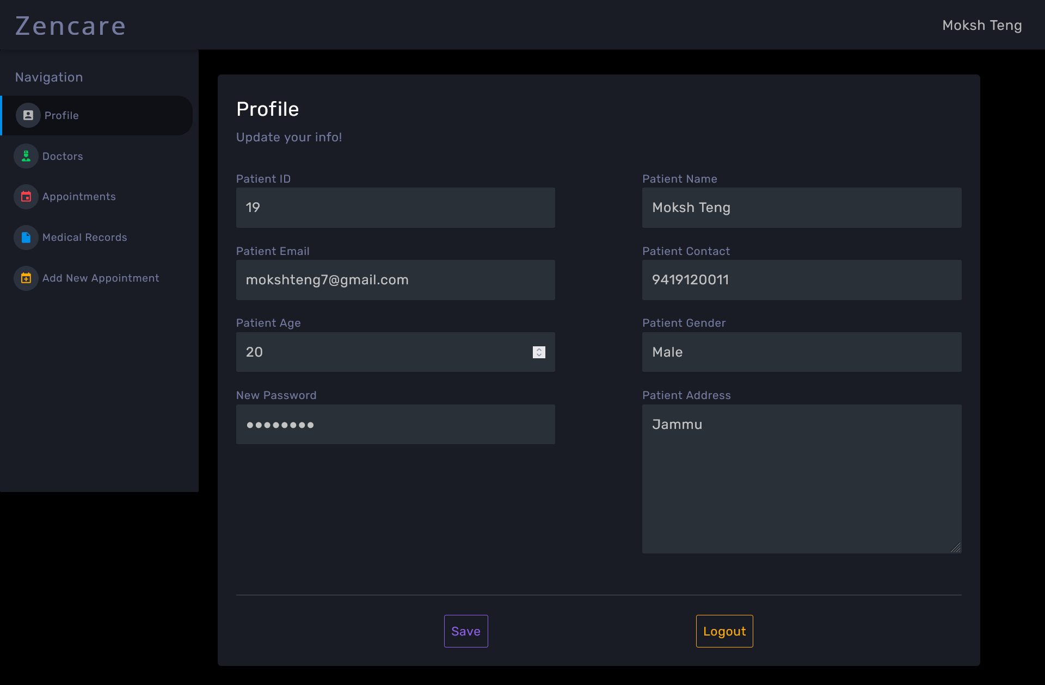

Slide 35
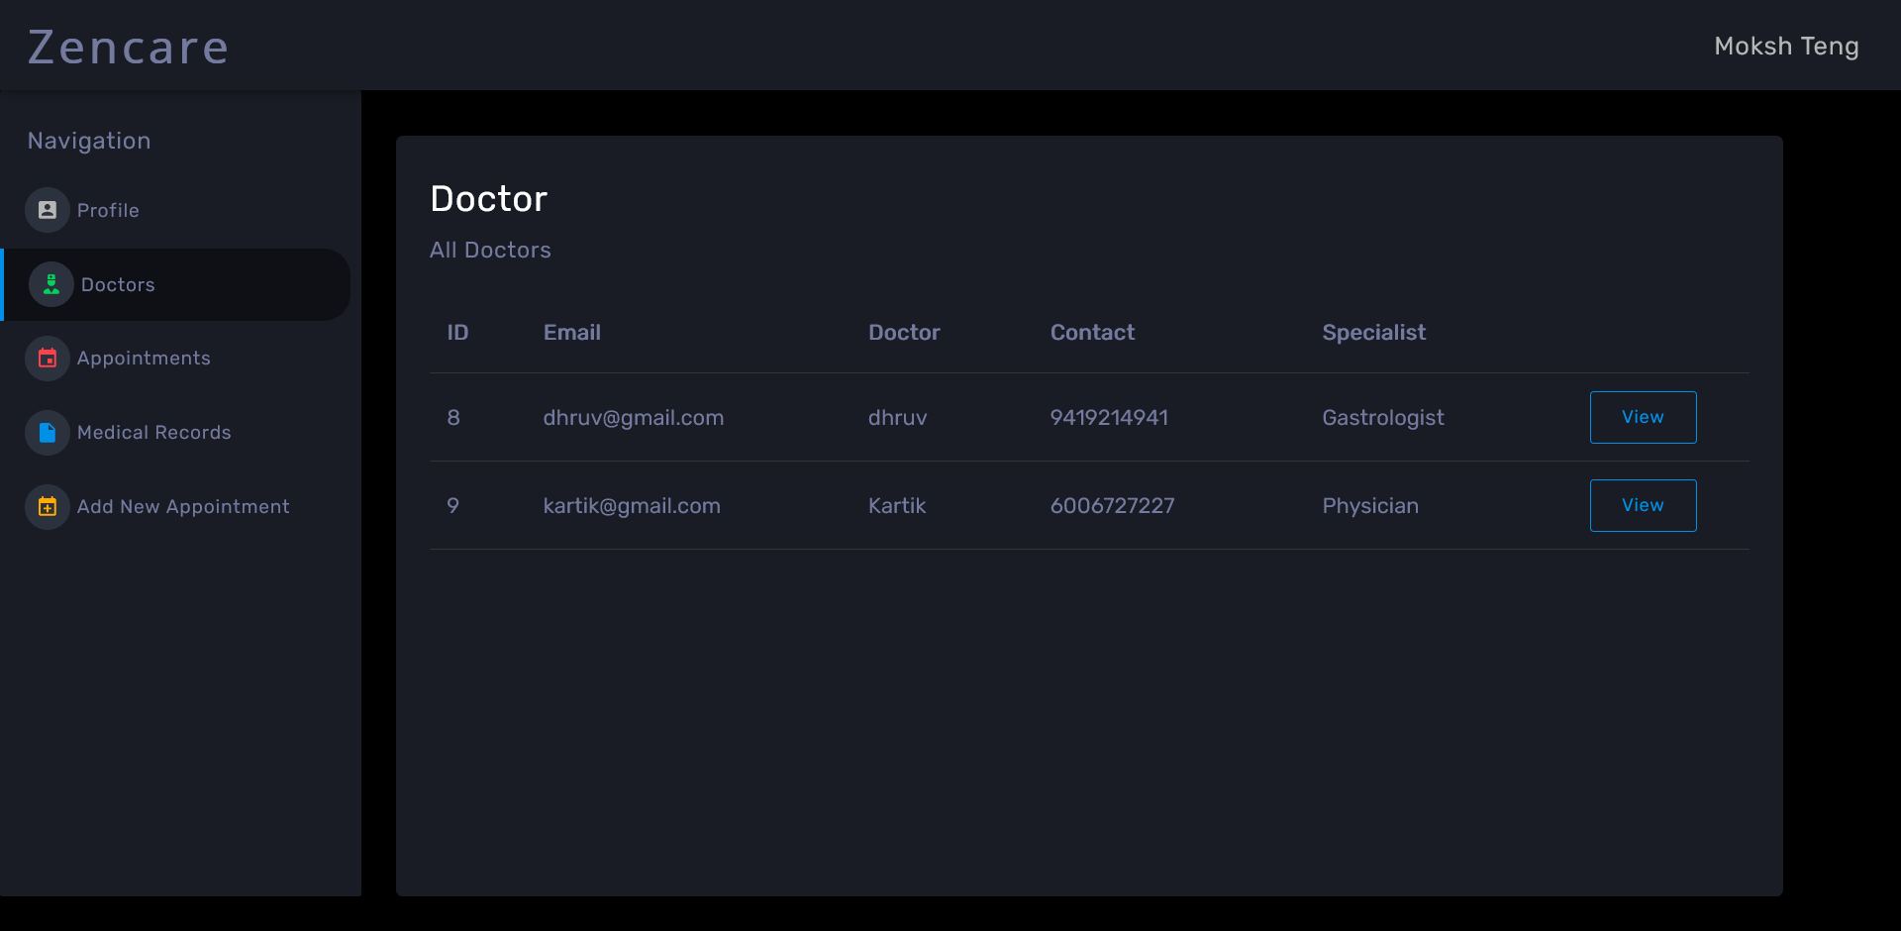

Slide 36
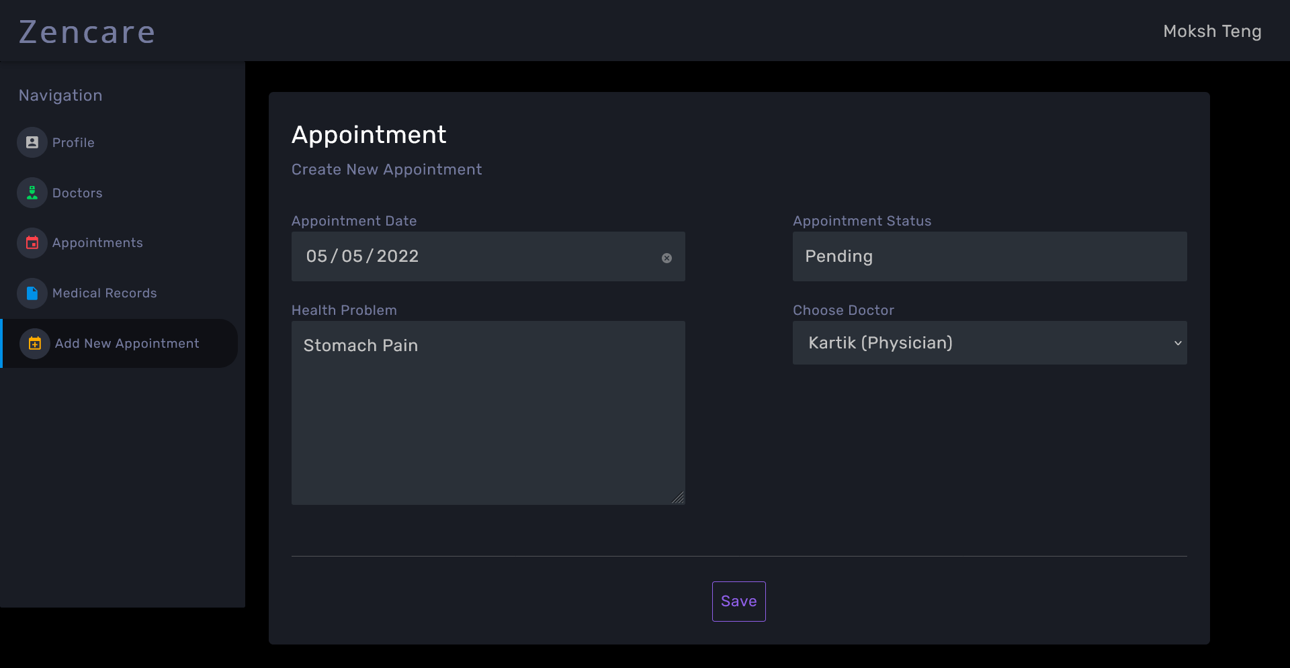

Slide 37
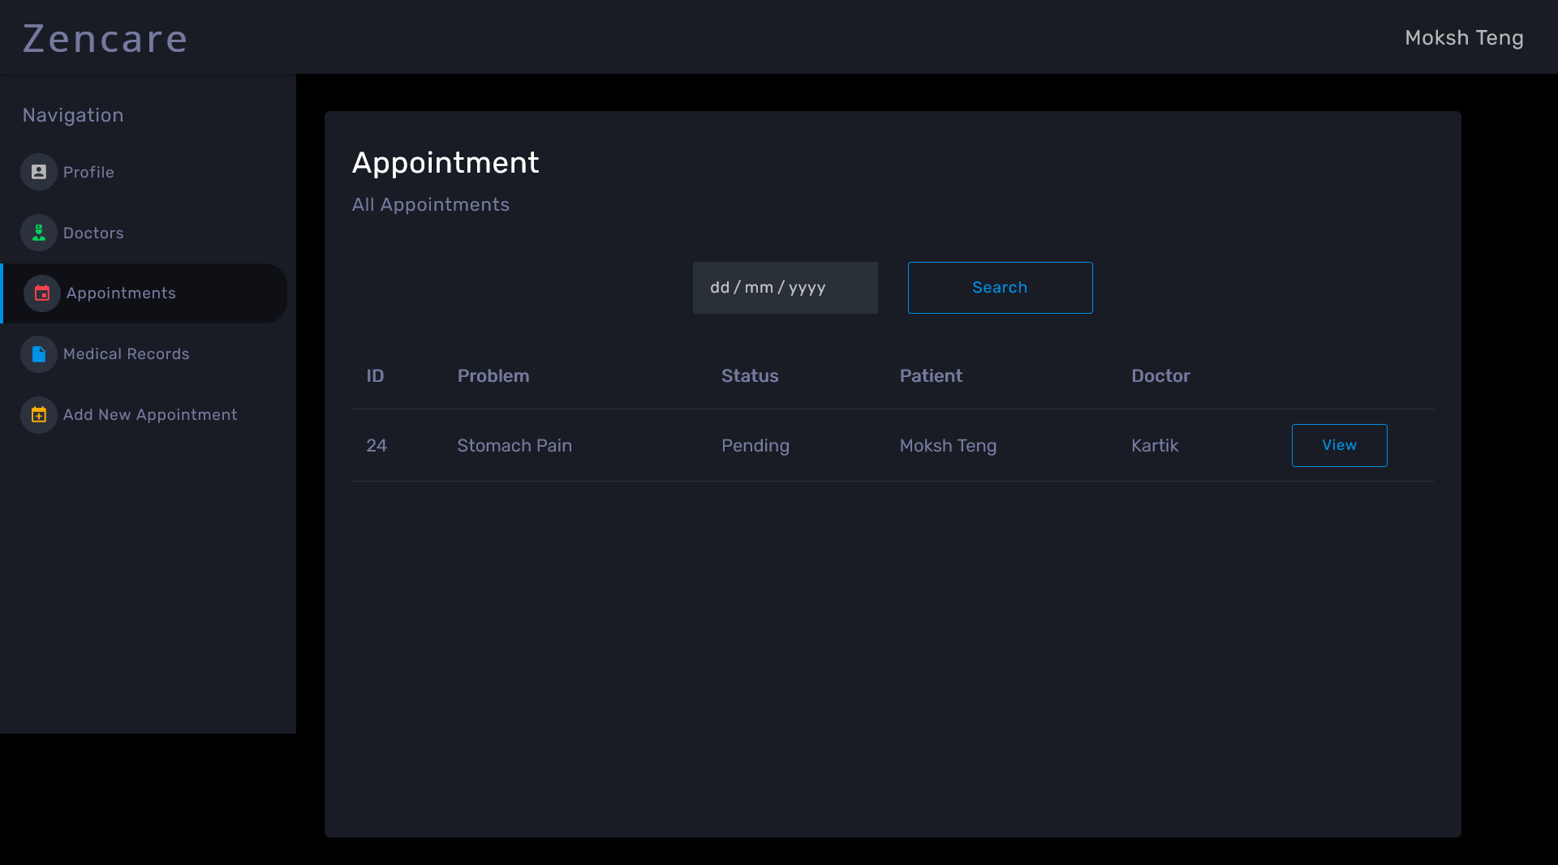

Slide 38
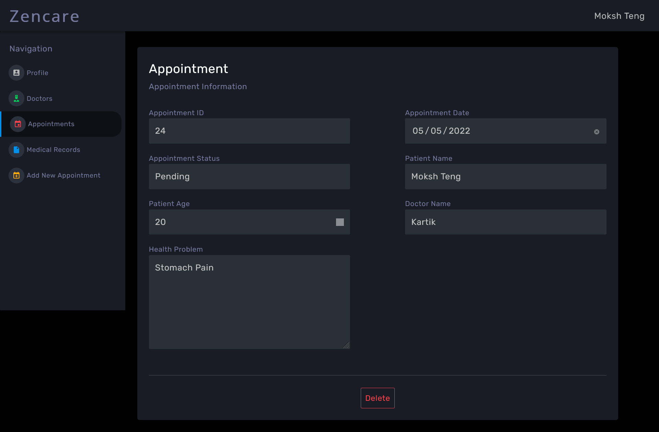

Slide 39
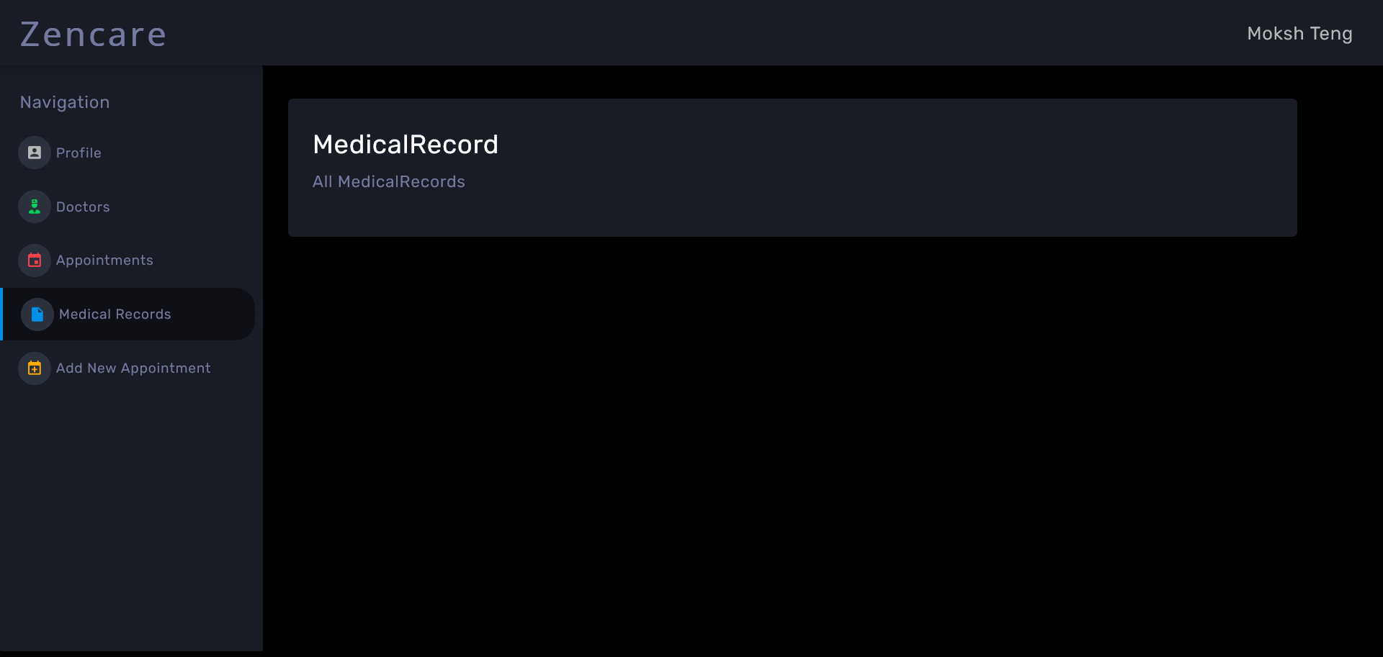

Slide 40
FUTURE SCOPE
Addition of chat application between doctors and patients.
Additional security additions like OAuth, email verification on patient signup.
Forgot password feature.
Patient Email can be updatable.
Data visualization of patient’s medical history.
Bill Management System

Slide 41


Slide 42
GITHUB LINKS
Frontend: https://github.com/moksh10/zencare
Backend: https://github.com/moksh10/E-HealthCare-Management-System-Server

Slide 43
Thank You

